Slide 1


Open SEARCH
Garvit Kumar Gupta
Under The Guidance of
Mr. Supratim Sen
&
Mr. Sundar Srinivasan

Slide 2

Objective
OpenSearch setup for CSE cloud as a replacement for ELK
2

Slide 3
Agenda
OpenSearch
Tenant
Saved Objects
Ingest Pipeline
File beat
Dashboard
&
Visualization
User , Roles
&
Roles Mapping
Summary

Slide 4

OpenSearch
The Apache 2.0-licensed search, analytics, and visualization suite with advanced security, alerting, SQL support, automated index management, deep performance analysis, and more
4

Slide 5
Why OpenSearch?
Robust security
Built-in integrations
Quickly deployed
&
Easily managed
Highly scalable
Open source API support
5

Slide 6
OpenSearch Use Case
Log analytics
Clickstream analytics
Search backend
Real-time application monitoring
6

Slide 7
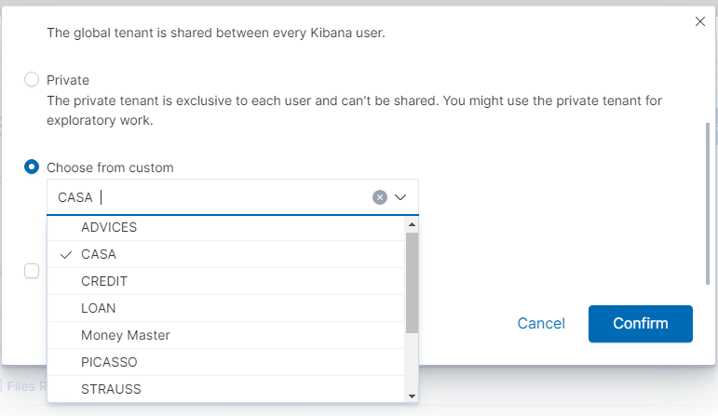
Tenants
Spaces for saving index patterns, visualizations, dashboards, and other OpenSearch Dashboards objects.
Useful for safely sharing our work with other OpenSearch Dashboards users.
Fig: Tenants I created using API (Currently in CASA)
7

Slide 8
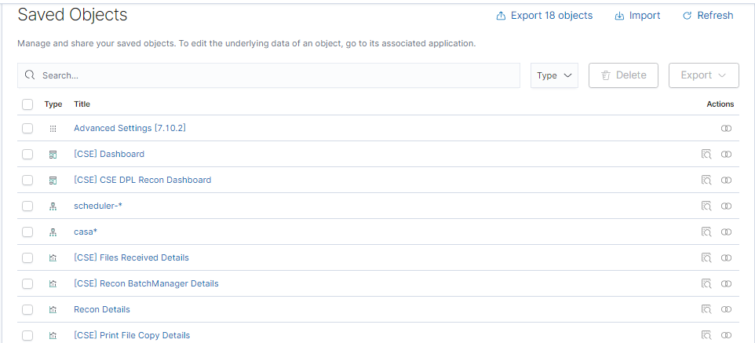
Saved Objects
These objects store data for later use, including dashboards, visualizations, maps, data views, Canvas work pads, and more.
Fig: Saved Objects in CASA Tenant
8

Slide 9
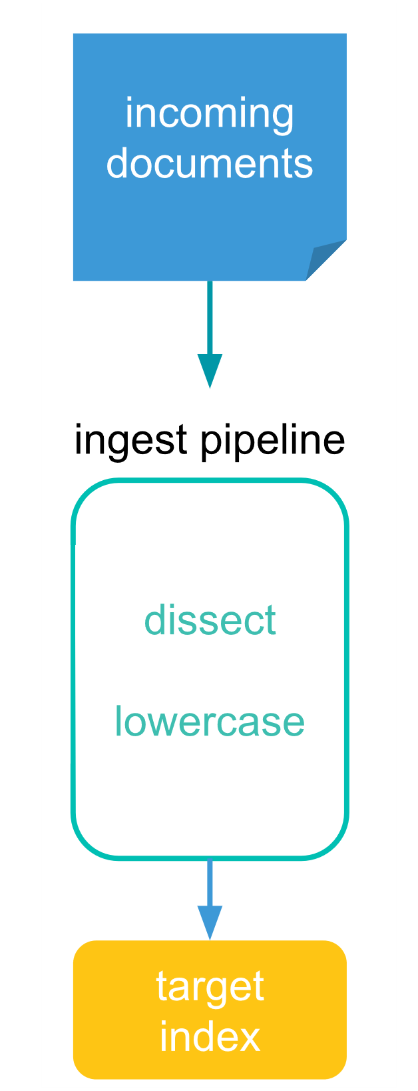
Ingest Pipelines
Ingest pipelines let you perform common transformations on your data before indexing.
For example, we can use pipelines to remove fields, extract values from text, and enrich your data.
9

Slide 10
Set
Split
Processors
Grok
Convert
Each processor runs sequentially, making specific changes to incoming documents. After the processors have run, Elasticsearch adds the transformed documents to your data stream or index.
Script

Slide 11

Filebeat
a lightweight shipper
monitors the log files
collects log events
forwards them to OpenSearch
beats
11

Slide 12
How To Push Logs To OpenSearch
Input
Filter
Output
File Beat
Ingest Pipeline
OpenSearch
12

Slide 13
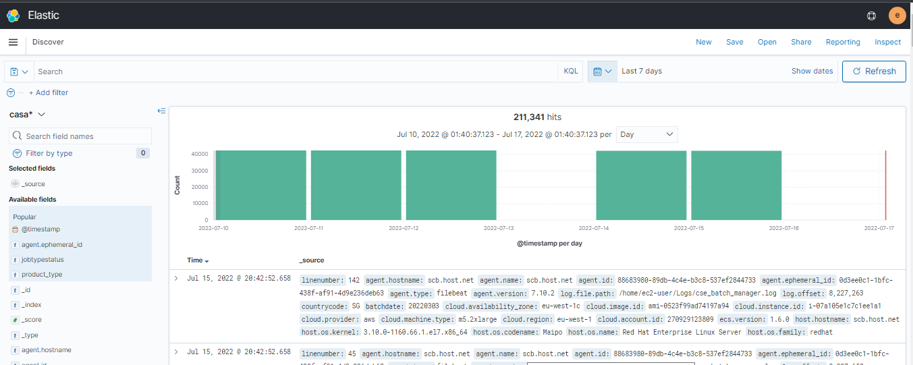
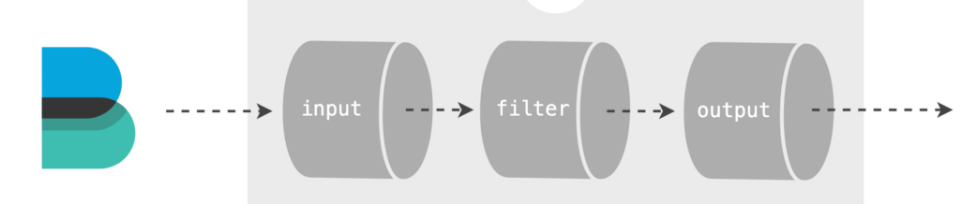
Discover
File Beat
Ingest Pipeline
OpenSearch
13

Slide 14
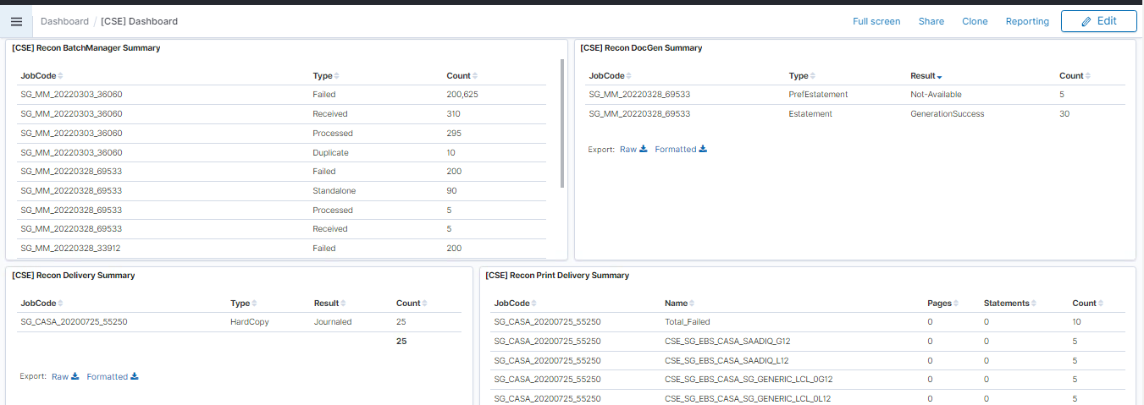
Dashboard
turn your data from one or more data views into a collection of panels
bring clarity to your data
tell a story about your data
focus on only the important data
Fig: [CSE] Dashboard in CASA Tenant
14

Slide 15
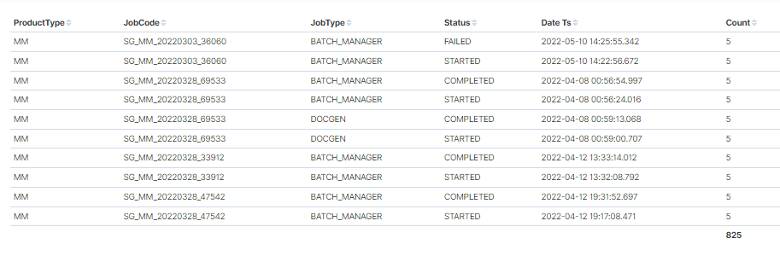
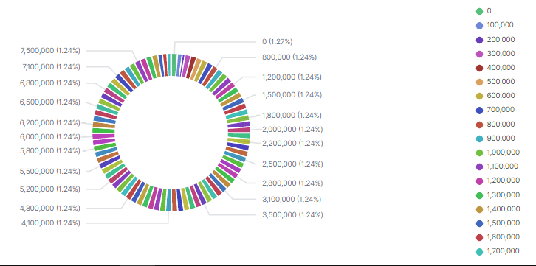
Visualizations
15

Slide 16
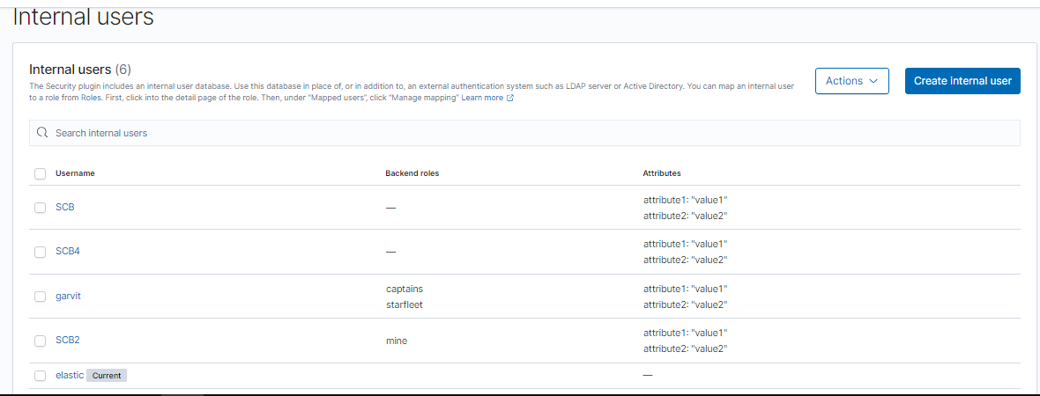
Users
Fig: All internal users (Current user is elastic)
16

Slide 17
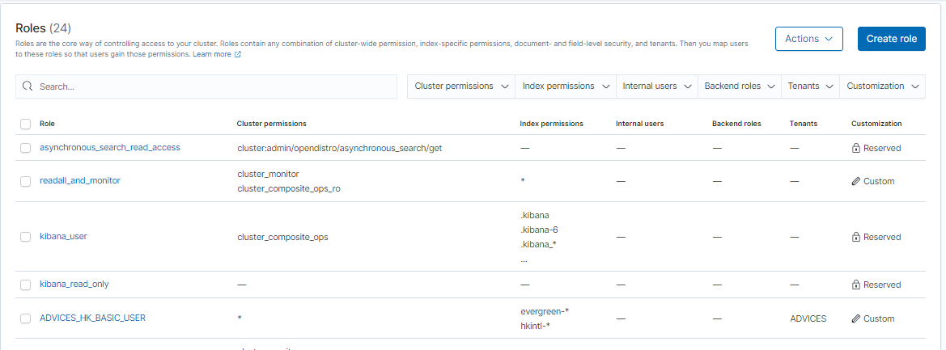
Roles & Roles Mapping
Roles are the core way of controlling access to your cluster.
Roles contain any combination of cluster-wide permissions, index-specific permissions, document- and field-level security, and tenants.
Then we can map users to these roles so that users gain those permissions.
Fig: Roles in OpenSearch
17

Slide 18
Challenges
Learning new Tech in a short period of time
Less explainable APIs of OpenSearch
VDI
18

Slide 19






Source and References
19

Slide 20


Summary
OpenSearch enables us to easily ingest, secure, search, aggregate, view, and analyze data. OpenSearch has been set up and configured for the CSE cloud as a replacement for the ELK platform. Various tenants and saved objects have been created for this purpose. Logs have been visualized with the help of dashboards. Roles have been also mapped to the various users using Open search APIs.
20

Slide 21




Thank you

